Slide 1
DG INTERNS HUB | CYBERSECURITY INTERNSHIP
WEEK 2
INTERNSHIP PRESENTATION
Network Analysis • Nmap • Windows Event Logs
Student: ____________________
GITAM, Visakhapatnam | CSE – Cyber Security
30 October 2026

Slide 2
Week 2 at a glance
Focus areas and practical learning
NETWORKING
PACKET ANALYSIS
RECONNAISSANCE
TCP handshake, HTTP, ICMP, host-only networking
Wireshark captures, display filters, packet inspection
Nmap host discovery, port and service scanning
WINDOWS LOGS
LEARNING
Security Event IDs and PowerShell event export
TryHackMe rooms, theory notes and cheat sheets
2

Slide 3
Objectives
What the week set out to achieve
Understand TCP connection establishment and common network protocols.
Capture and interpret network traffic using Wireshark.
Perform controlled Nmap scans against a personally managed Ubuntu VM.
Review Windows Security events and retrieve event data with PowerShell.
Document practical findings in a SOC-oriented workflow.
3

Slide 4
Virtual lab environment
Kali Linux and Ubuntu connected using VirtualBox Host-only networking
KALI LINUX
UBUNTU
Host-only network
192.168.56.104
192.168.56.103
Testing machine
Wireshark + Nmap
Target machine
Apache web server
Connectivity validation: ping succeeded (4/4 replies). HTTP test with curl returned the Apache default page and HTTP 200 OK.
4

Slide 5
Apache server and connectivity
Ubuntu hosted a web page; Kali verified access
SERVICE STATUS
PING TEST
HTTP TEST
Apache service confirmed active (running) on Ubuntu.
Kali → Ubuntu: 4 packets received, 0% packet loss.
curl returned the Apache default page; HTTP 200 OK.
Evidence to insert: Apache service status screenshot, successful ping, and curl / HTTP response.
5

Slide 6
Wireshark packet analysis
Observed traffic generated by connectivity and scanning tests
TCP three-way handshake: SYN → SYN/ACK → ACK.
HTTP request/response traffic from the Apache test.
ICMP echo request and echo reply packets.
Nmap SYN packets visible during the port scan.
ANALYSIS APPROACH
Used capture/display filters to isolate relevant protocols and inspect packet details.
Insert your own Wireshark screenshots here.
6

Slide 7
Nmap scanning
Controlled scans against the Ubuntu VM
Command | Purpose | Observed result / status
-sn | Host discovery | Ubuntu host reported up.
-sS | TCP SYN scan | Port 80/tcp reported open; HTTP service.
-sV | Service detection | Apache httpd 2.4.66 (Ubuntu) identified.
-O | OS detection | Scan completed; no exact OS match identified.
-A | Aggressive scan | Not confirmed as completed; do not claim as evidence.
Only include output files for scans actually completed in the final evidence folder.
7

Slide 8
Windows Security event investigation
Reviewed selected events on the Windows host
EVENT ID 4648
EVENT ID 4672
POWERSHELL
A logon was attempted using explicit credentials.
Special privileges were assigned to a new logon.
Used Get-WinEvent to retrieve and export selected event details.
Multiple 4648 and 4672 events were observed around 29 October 2026 at approximately 16:58. These events require context and correlation; they do not independently prove malicious activity.
8

Slide 9
Challenges and troubleshooting
Issues encountered and how they were addressed
VM CONNECTIVITY
PACKET IDENTIFICATION
Both VMs initially used NAT. Added Host-only adapters and checked their IP addresses.
Applied Wireshark display filters and inspected TCP, HTTP, ICMP and SYN traffic.
POWERSHELL EXPORT PATH
WINDOWS SECURITY LOG
Checked the Desktop path and verified the export file using Test-Path.
The Security log was accidentally cleared. Historical evidence was not assumed recoverable; findings were documented honestly.
9

Slide 10
Guided learning and reference material
Theory notes, TryHackMe practice and cheat sheets
Further Nmap
Live Host Discovery
Basic Port Scans
Windows Basics
Windows Fundamentals 1
Windows Fundamentals 2
WIRESHARK CHEAT SHEET
20 useful display filters with meanings and uses.
WINDOWS EVENT ID CHEAT SHEET
15 important security Event IDs and SOC uses.
10

Slide 11
Skills practised
Practical skills developed during Week 2
Linux service management and Apache web-server validation.
VirtualBox networking and connectivity troubleshooting.
Packet capture and protocol inspection using Wireshark.
Nmap host discovery, port scanning and service identification.
Windows Security log review and PowerShell event retrieval.
Technical documentation and SOC-oriented evidence handling.
11

Slide 12
KEY TAKEAWAYS
From concepts to practical security monitoring
Connected Kali and Ubuntu and validated an Apache web service.
Captured and interpreted network traffic with Wireshark.
Performed Nmap scans and reviewed Windows security events.
Improved troubleshooting, analysis and technical documentation skills.
Thank you

Slide 13
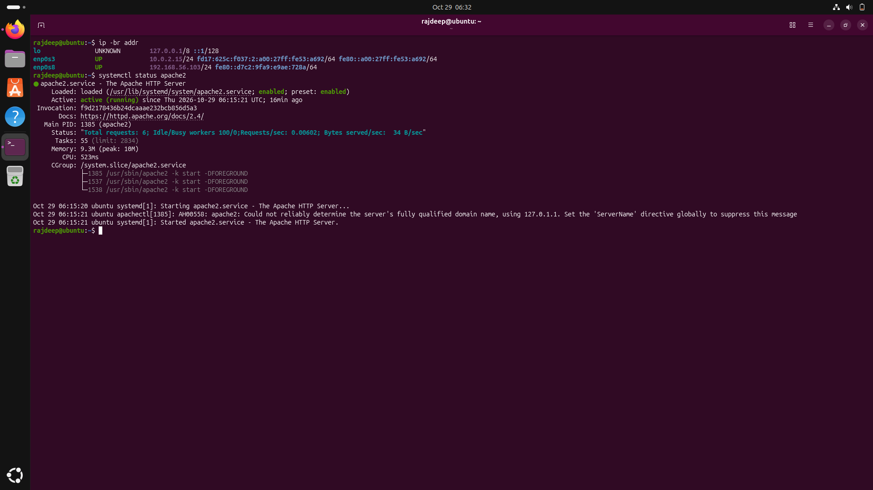

Slide 14
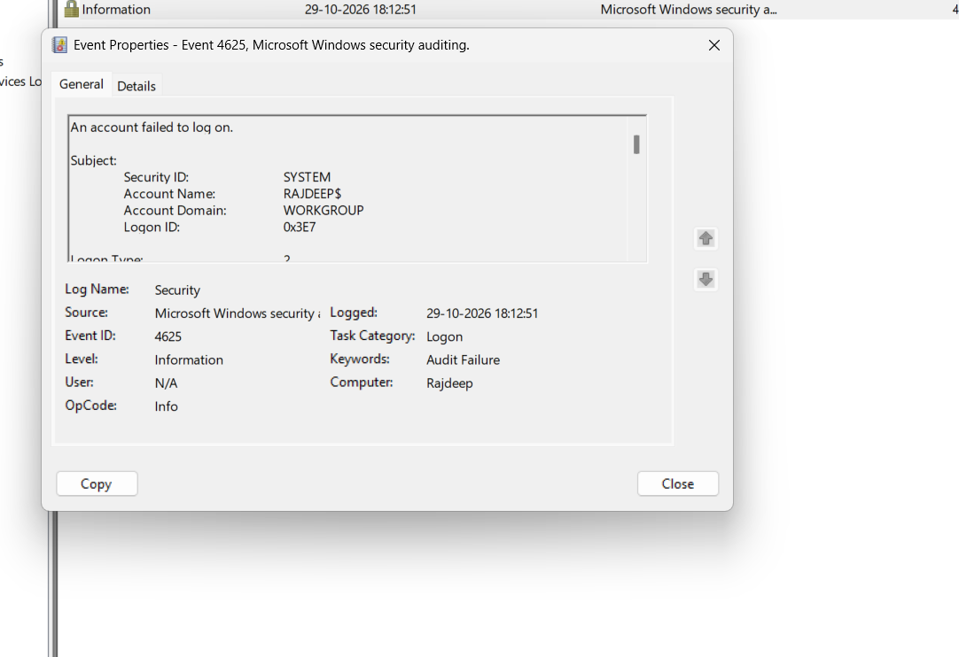

Slide 15
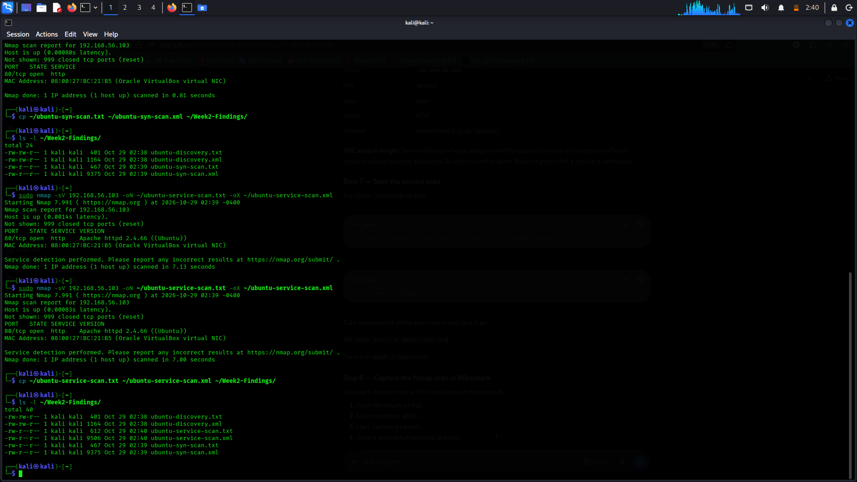

Slide 16
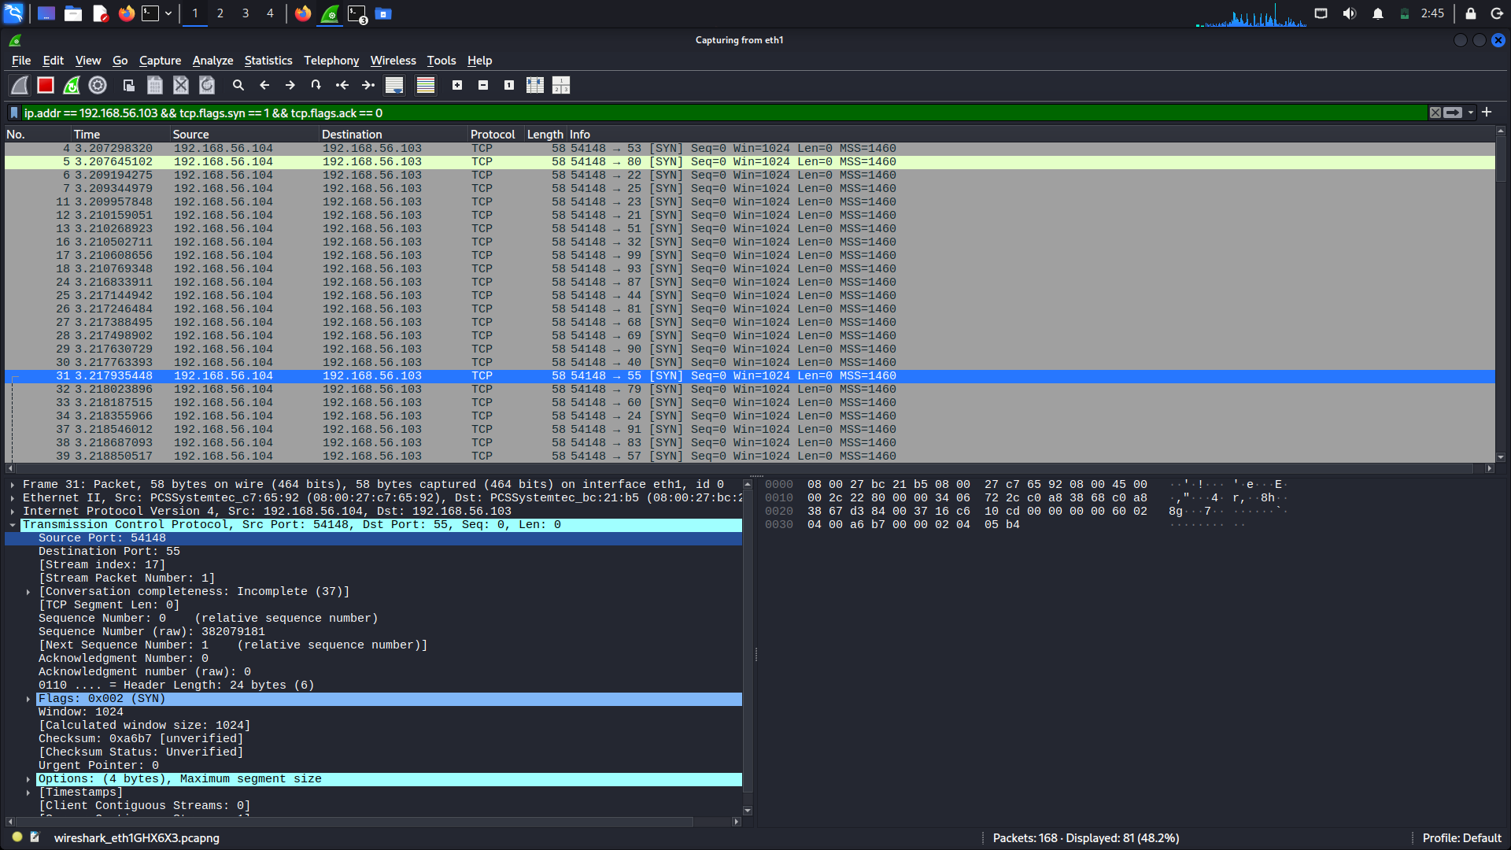

Slide 17


